Slide 1



X
Final Task Evaluasi Kinerja Bisnis Kimia Farma
Kimia Farma - Big Data Analytics
Presented by
Meilani Tri Pamintaningtyas

Slide 2





Meilani Tri Pamintaningtyas
Final Task PBI Kimia Farma
I'm a student from Yogyakarta State University structured I'm a good communicator with proven interpersonal skills and am used to working in a team whilst also being capable of using own initiative. I'm skilled In dealing with problems in a resourceful manner and negotiating to achieve beneficial agreement. I'm always enthusiastic to learn and undertake new challenges.
Yogyakarta
meilanitri65@gmail.com
https://www.linkedin.com/in/meilanitrip/

Slide 3
Courses and Certification
Certificate of Competence
has been competence in the area of Office Application with qualification/competence “Operator Komputer Muda” on Behalf of Indonesian Professional Certification Authority
Desember, 2023

Slide 4

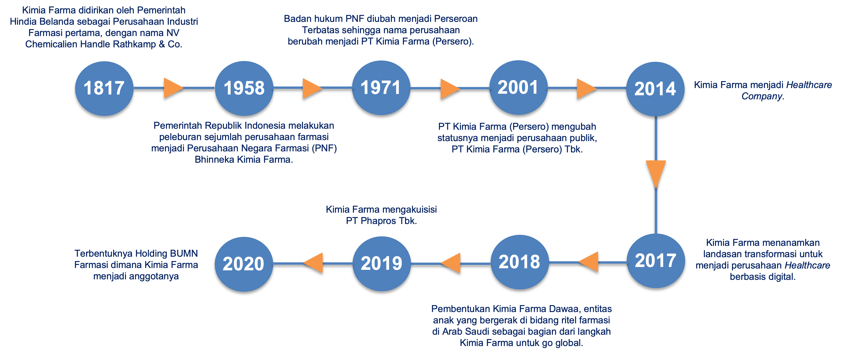
About Company

Slide 5
Project Portfolio
Proyek utama PBI Kimia Farma adalah mengevaluasi kinerja bisnis Kimia Farma dari tahun 2020 hingga 2023. Dataset yang telah disediakan:
kf_final_transaction.csv
kf_inventory.csv
kf_kantor_cabang.csv
kf_product.csv

Slide 6
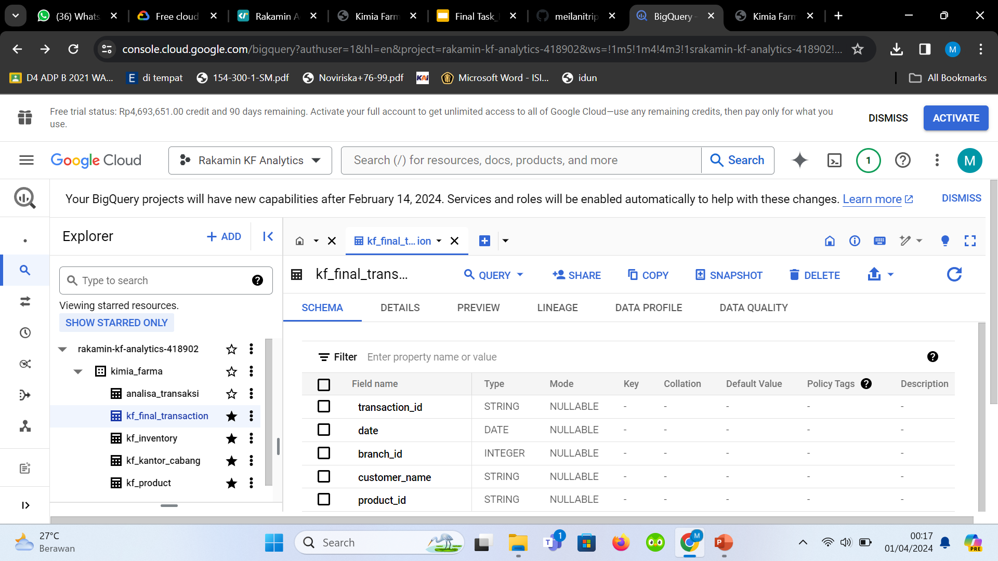
Importing Dataset to BigQuery

Slide 7
Importing Dataset to BigQuery
Klik rakamin-kf-analytics-418902 > create dataset > lengkapi dataset ID dengan “kimia_farma”, location type “region” – “Asiansoutheast2 (Jakarta)” > klik button biru “create dataset”
Create table > create table from “upload” > destination project “rakamin-kf-analytics-418902” > dataset “kimia_farma” > berikan nama table sesuai ketentuan > table type “native table” > klik schema > klik button biru “create table”

Slide 8
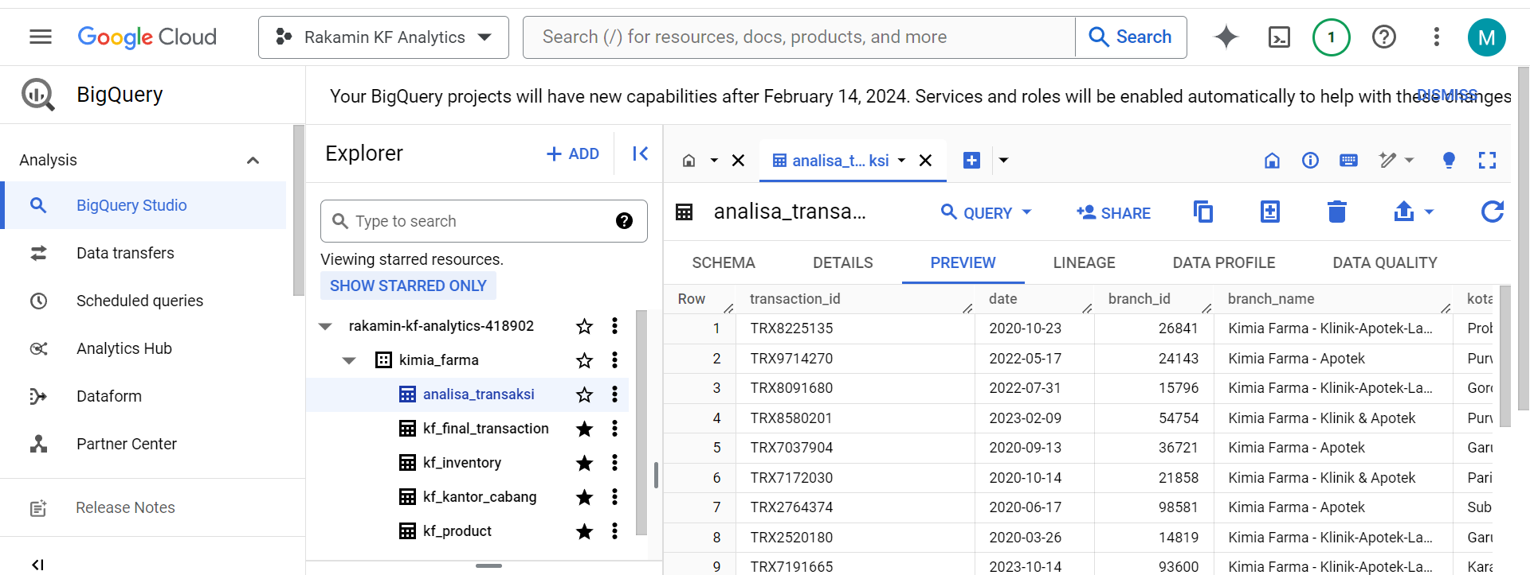
Tabel Analisa

Slide 9
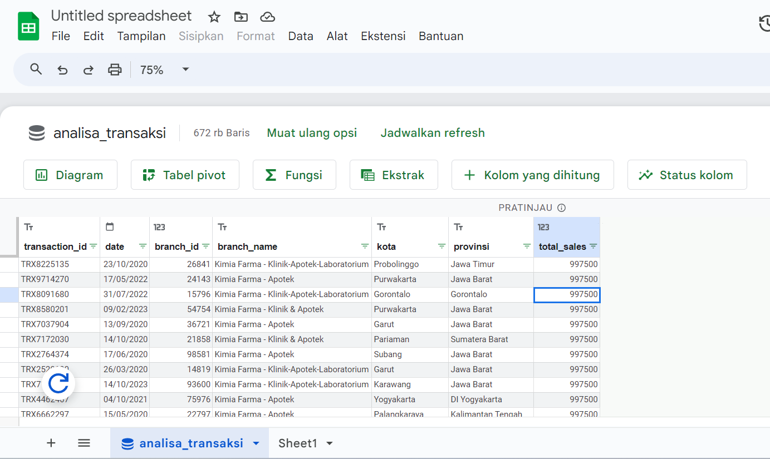
Tabel Analisa

Slide 10
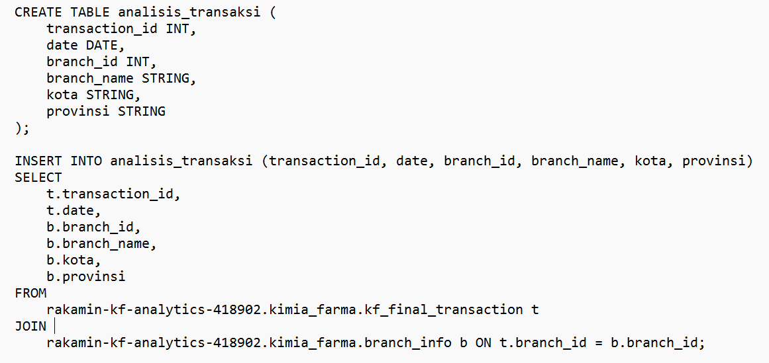
BigQuery Syntax

Slide 11
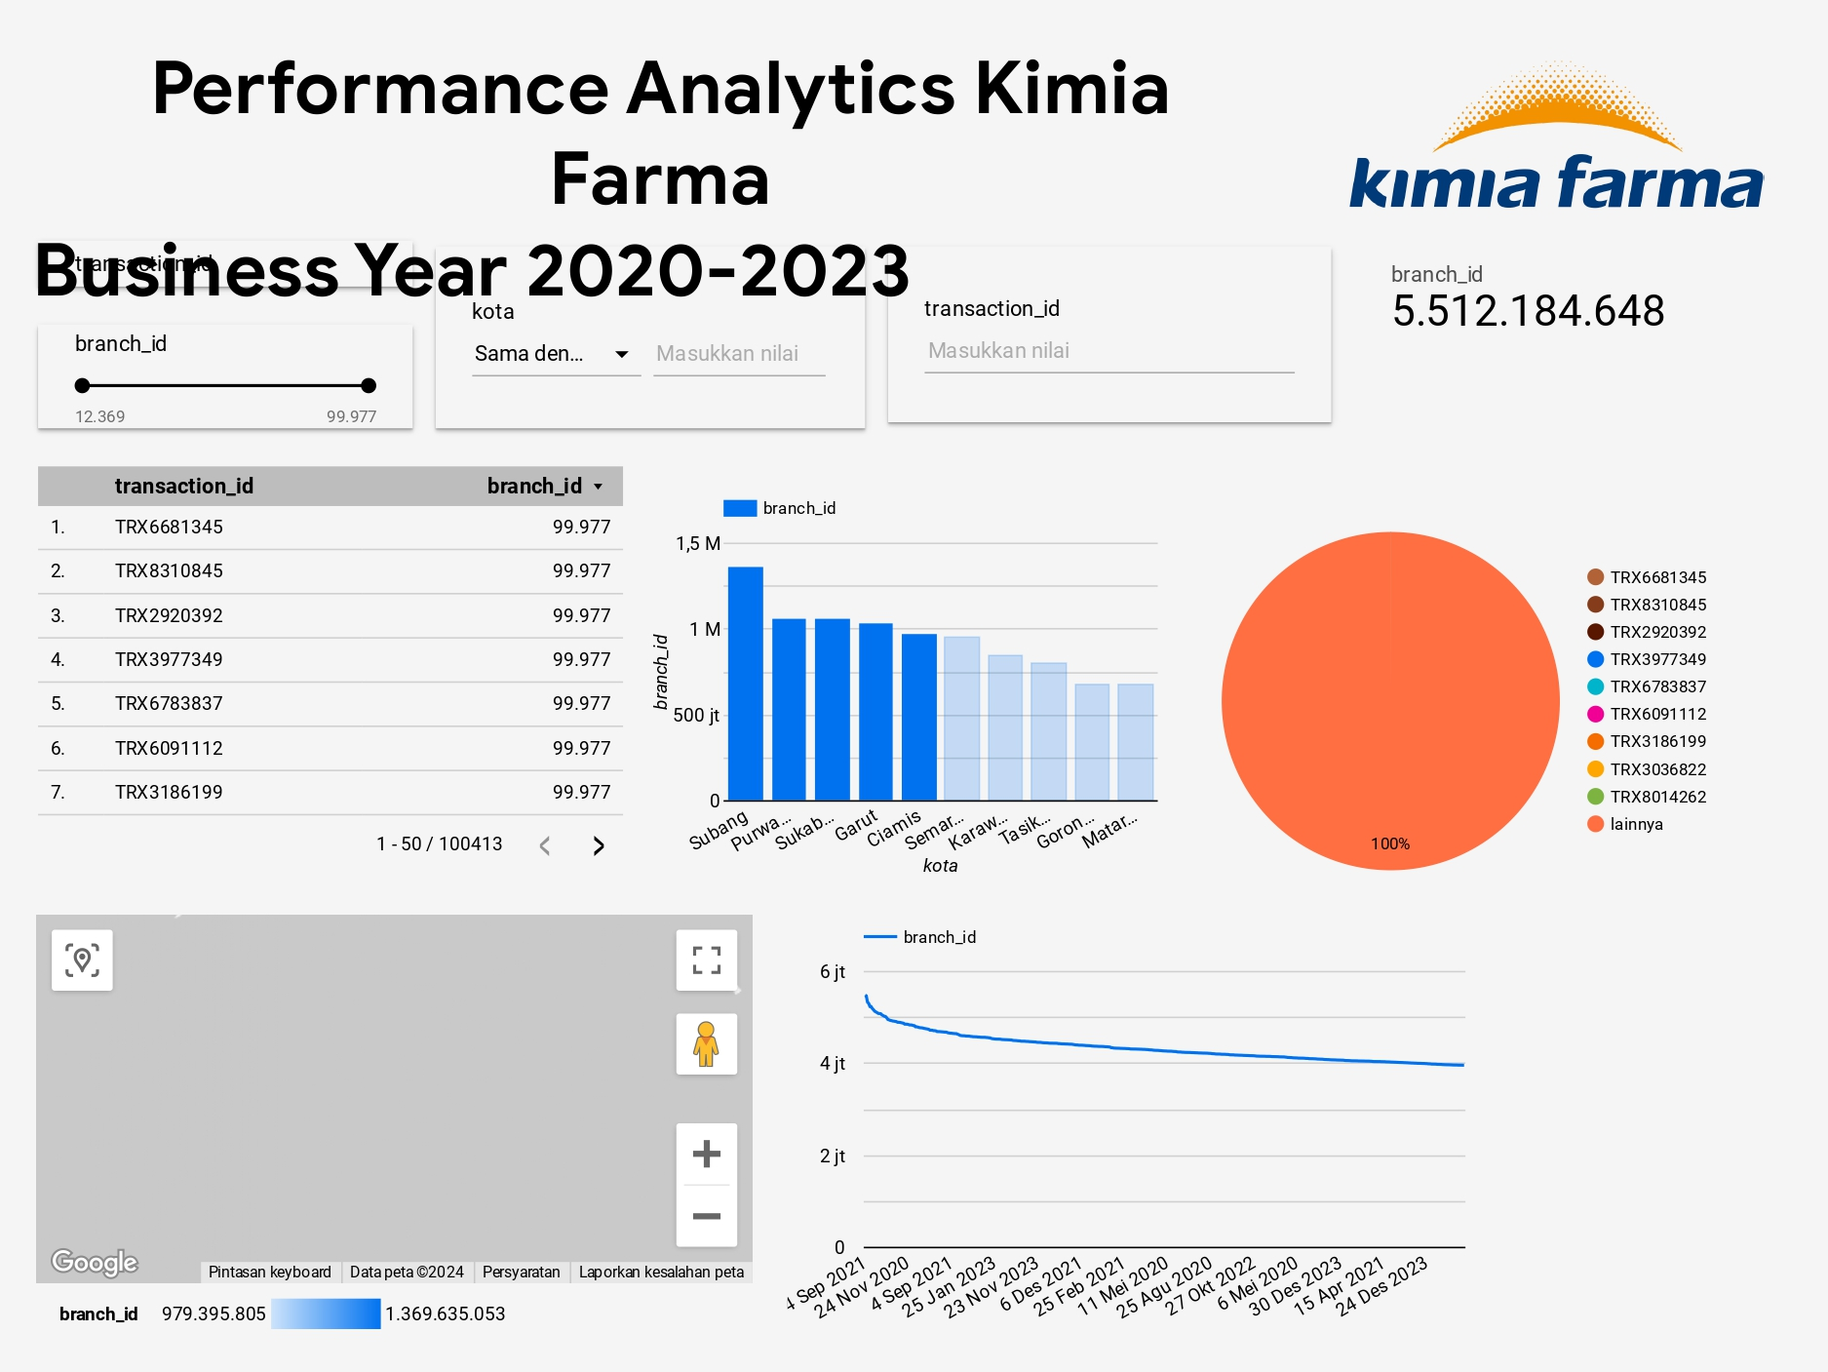
Dashboard Performance Analytics

Slide 12
Link Youtube & Github Repository
https://drive.google.com/drive/folders/1B2Hm1aje3BEQnmj8RtL8odXAm-UQv1J9?usp=sharing
https://github.com/meilanitrip/FinalTaskProjectBasedInternshipKimiaFarma

Slide 13
Thank You
X

